Slide 1
DIGITAL PORTFOLIO

Slide 2
ABOUT
STUDENT NAME : S.AKSHAYA
REG.NO&NMID:222403798/asunm293222403798
DEPARTMENT: BSC COMPUTER SCIENCE
COLLEGE NAME: VIDHYA SAGAR WOMEN’S COLLEGE.

Slide 3
MY PORTFOLIO
BY:
S.AKSHAYA

Slide 4
AGENDA
PROJECT OVERVIEW
END USE
TOOLS AND TECHNOLOGIES
PORTFOLIO DESIGN AND LAYOUT
FEATURES AND FUNTIONALITY
RESULT AND SCREENSHOT
CONCLUSION
PROBLEM STATEMENT
GITHUB LINK

Slide 5
PROBLEM STATEMENT
Background/Context – Briefly explain the situation or field where the problem exists.
Existing Problem – Clearly state the issue or gap that needs to be solved.
Impact of the Problem – Explain why this problem is important and what negative effects it causes.
Need for a Solution – Highlight why solving the problem is necessary now.
Scope of the Solution – Define what the solution should achieve (without giving the full solution yet).

Slide 6
Project Overview
The project focuses on addressing a real-world problem with innovative and practical solutions.
It aims to enhance awareness, improve efficiency, and promote sustainability in the chosen domain.
The project makes use of modern tools, techniques, and technologies to ensure effective implementation.
It highlights the importance of skill development and problem-solving among students.
The outcome of the project is expected to provide valuable insights and contribute to future improvements in society or industry.

Slide 7
END USE
The project can be used by students, teachers, and professionals to improve knowledge and skills.
It provides a practical solution that can be implemented in real-life situations.
The system helps in saving time, reducing cost, and increasing efficiency.
It creates awareness and promotes better decision-making among users.
The project contributes to sustainable practices and long-term benefits for society.

Slide 8
TOOLS AND TECHNOLOGIES
Programming Languages – Python, Java, or C++ for developing the core logic.
Web Technologies – HTML, CSS, JavaScript for frontend development.
Database – MySQL / Mongo DB for storing and managing data.
Frameworks – Django, Flask, or React for building applications efficiently.
Tools – GitHub for version control, VS Code / PyCharm as IDE.
APIs & Libraries – Pandas, NumPy, Matplotlib for data analysis and visualization.
Cloud Platforms – AWS, Google Cloud, or Azure for hosting and deployment.

Slide 9
PORTFOLIO DESIGN AND LAYOUT
Clean and Simple Layout – Designed with a user-friendly interface for easy navigation.
Responsive Design – Ensures the portfolio looks good on desktops, tablets, and mobile devices.
Organized Sections – Includes sections like About Me, Projects, Skills, Achievements, and Contact.
Visual Appeal – Uses consistent colors, fonts, and styles to maintain a professional look.
Interactive Elements – Features clickable links, buttons, and project previews for better engagement.
Use of Modern Tools – Designed using HTML, CSS, JavaScript (and frameworks if used).
Minimal Yet Informative – Focused on showcasing strengths without overcrowding the layout.

Slide 10
FEATURES AND FUNTIONALITY
User-Friendly Interface – Simple and easy-to-use design for smooth navigation.
Responsive Design – Works seamlessly on desktop, tablet, and mobile devices.
Secure Authentication – Provides login and registration with data security.
Database Connectivity – Stores and retrieves user data efficiently.
Search and Filter Options – Allows users to quickly find the required information.
Interactive Dashboard – Displays data, reports, or project outputs clearly.
Customization – Users can personalize certain features according to their needs.
Error Handling – Provides proper alerts and validations to avoid mistakes.

Slide 11
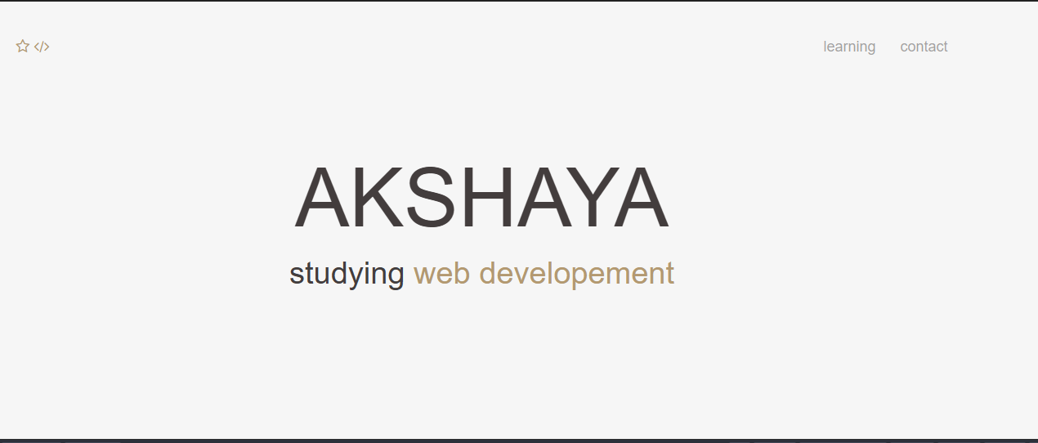
RESULT AND SCREENSHOT

Slide 12
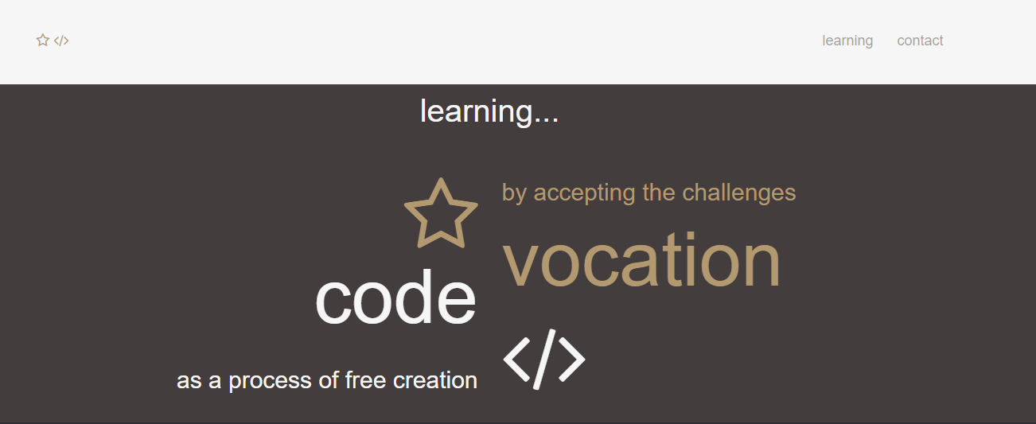
RESULT AND SCREENSHOT

Slide 13
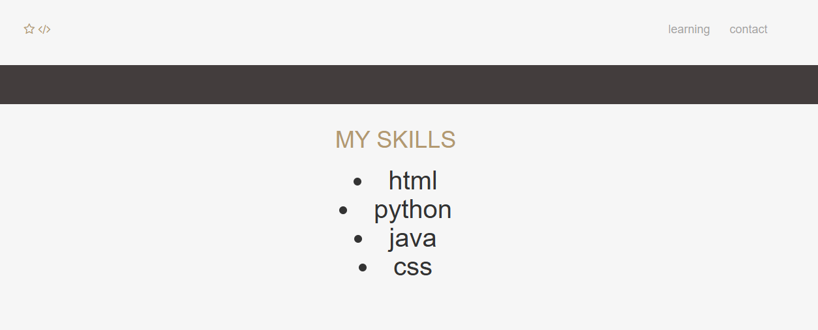
RESULT AND SCREENSHOT

Slide 14
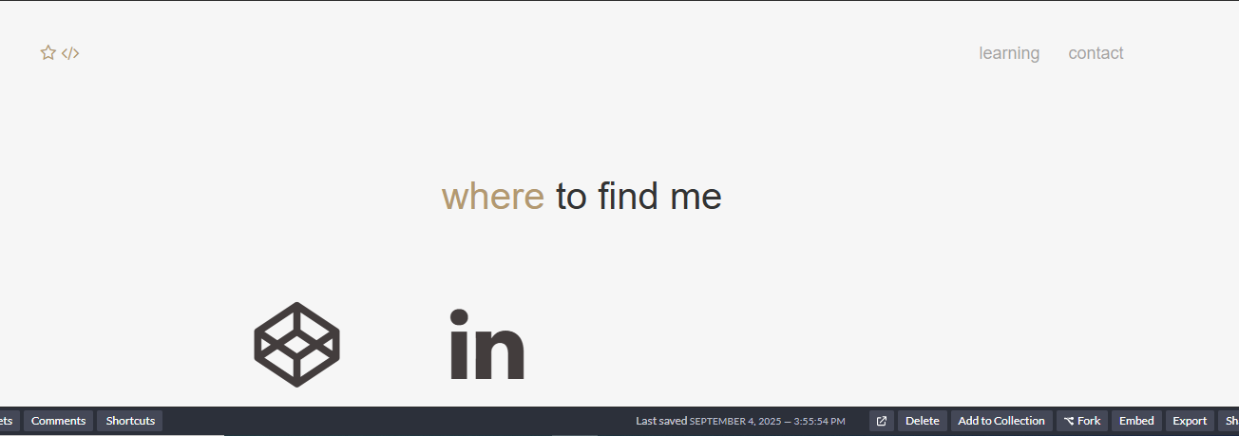
RESULT AND SCREENSHOT

Slide 15
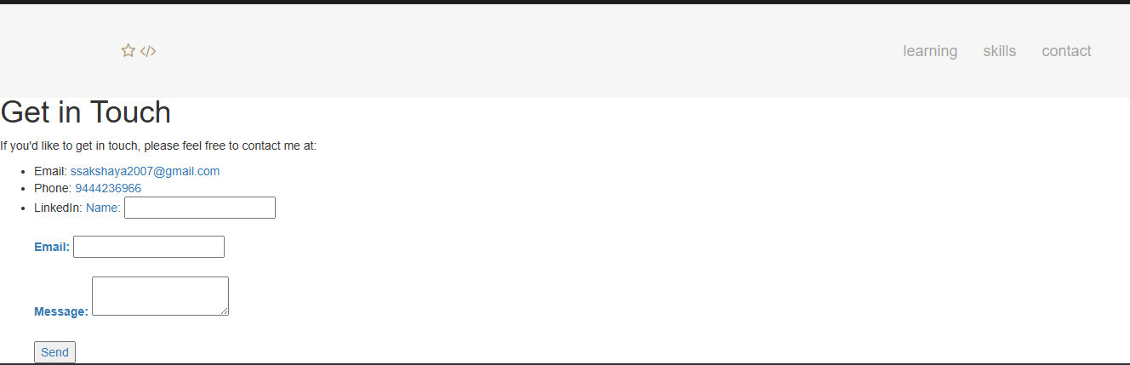
RESULT AND SCREENSHOT

Slide 16
conclusion
The digital portfolio serves as a professional platform to showcase personal skills, projects, and achievements in an organized manner.
It highlights creativity, technical knowledge, and the ability to design user-friendly web pages.
The project demonstrates the use of HTML, CSS, and other tools to build a responsive and visually appealing portfolio.
Through this portfolio, future opportunities such as internships, jobs, or academic recognition can be enhanced.
Overall, the digital portfolio acts as a reflection of both personal growth and technical competency.

Slide 17
Thanking you

